Slide 1
CAUSE OF DEATH
ARUP CHAKRABORTY
INTERNSHIP 34

Slide 2
1.This Dataset contains Historical Data on Causes of Death around the World 2. Reading the dataset 3. First 5 rows in the dataframe 4. Collecting Information about Dataframe 5.collecting the Statistical Information of Dataframe 6. Checking for null values in the Datafrme 7. Checking The unique Year data in the Dataframe 8.Checking the Correlation of various causes of death against year 9.Checking the Columns in the Dataframe 10.Checking the Total no.of Countries in the DataFrame

Slide 3
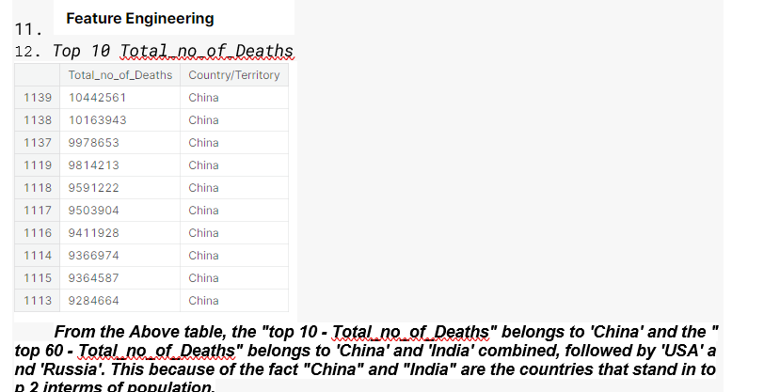

Slide 4
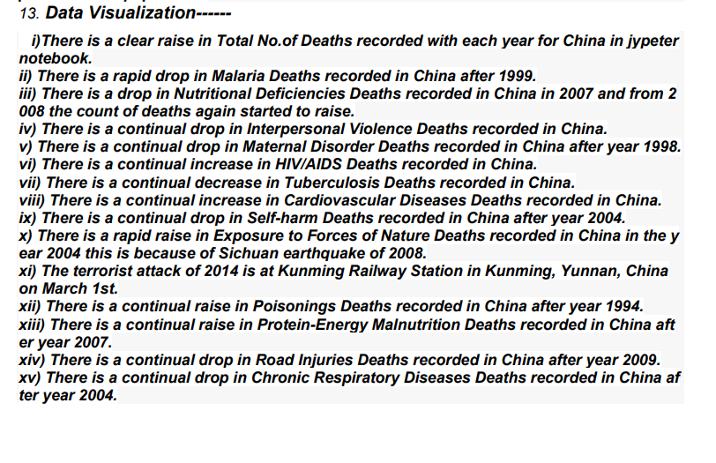

Slide 5
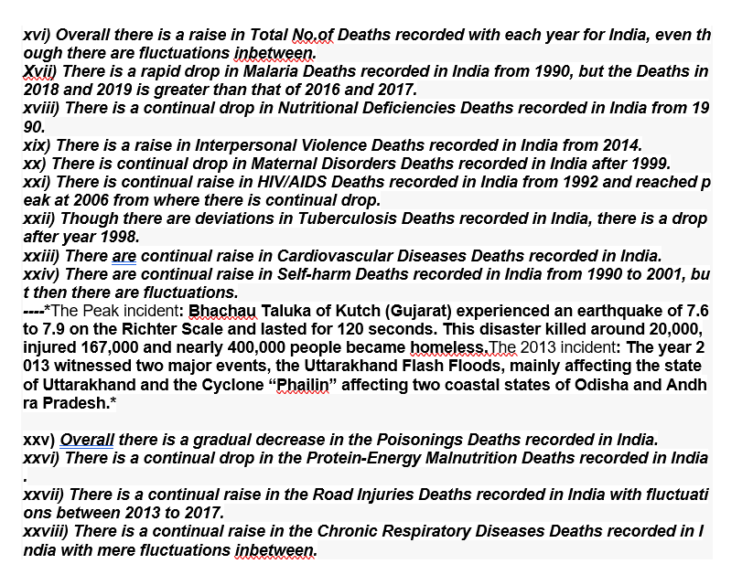

Slide 6
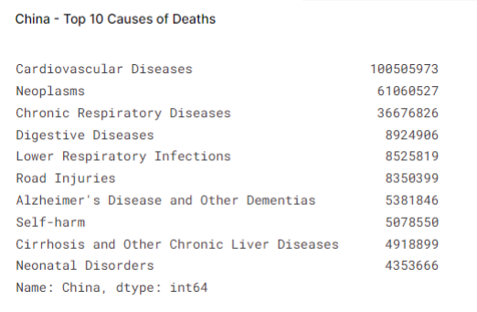

Slide 7
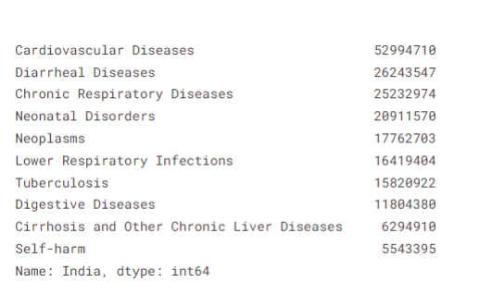
INDIA-TOP 10 CAUSE OF DEATHS

Slide 8
